Slide 1
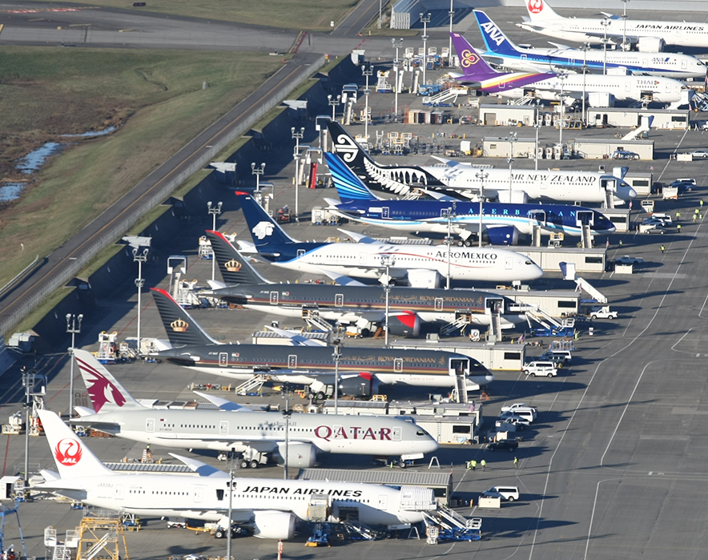
Applied Machine Learning in the Airline Industry
Camila Asprilla
MAT 602: Applied Machine Learning
Prof. Norge Pena Perez

Slide 2
Introduction
This dataset has 21 columns that contain formation from 2013-2023. Because of a RAM memory constraint and multiple failed attempts, I decided to reduce the data points to capture only the information from the year 2023. The following features were used for this study::
First, our dependent variable (Y):
carrier_name: This refers to the name of the airline.
Then we have our independent variables(X’s):
arr_flights (X1): Number of arriving flights
arr_del15 (X2): Number of flights that were delayed by 15 minutes or more.
arr_delay (X3): Total number of flights that arrived arrival late.
carrier_delay (X4): Delay attributed to the airline.
weather_delay (X5): Delay attributed to the weather.

Slide 3

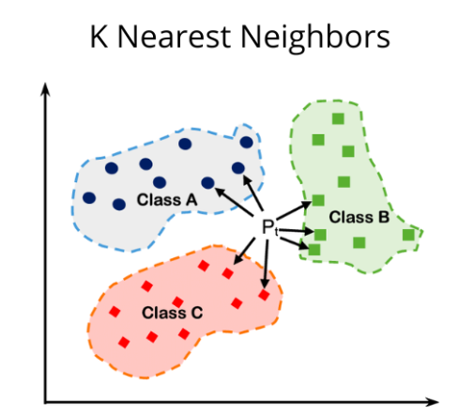
Methodology

Slide 4
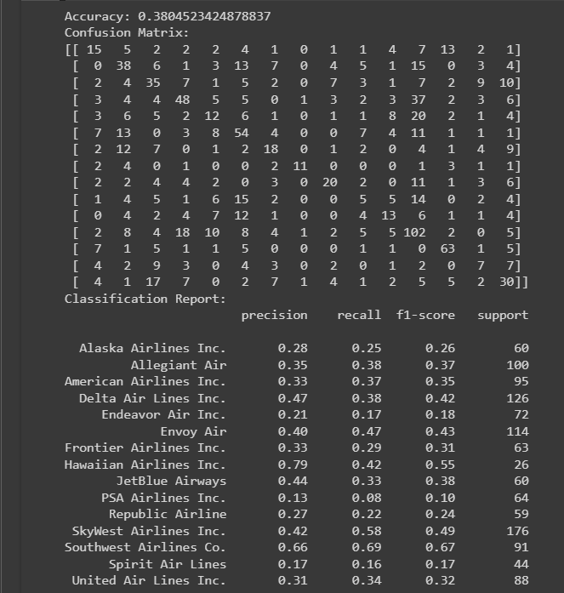
Discussion
Precision: Measures the accuracy of any positive predictions, meaning positives that are positive, in this case, the “most accurate” results was for Hawaiian Airlines (79% precise).
Recall: Is the ratio of true positives and the summation of true positives and false negatives. Southwest airlines have the highest recall rate at 69%.
F-1 Score: Equates the precision divided by the recall rate to produce an average measure of the model’s performance. These are the results that matter the most. Based on this calculation, Southwest airlines continues to have the most delays.

Slide 5
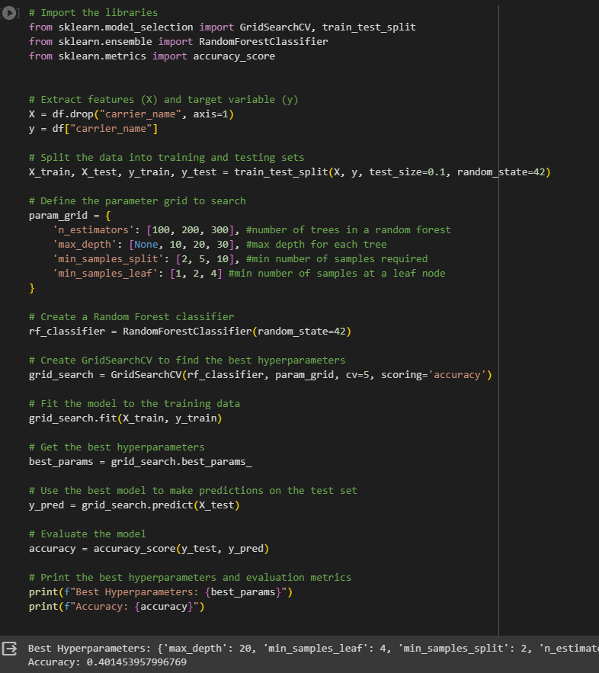
Discussion Cont’d
Finally, I decided to hyperparameter tune the model to see if by including more precise specifications the model would significantly improve. As a result, I received a 40.14% accuracy rate. Because this is not a significant improvement in the accuracy of the model, I decided to still move forward with the results from above.

Slide 6
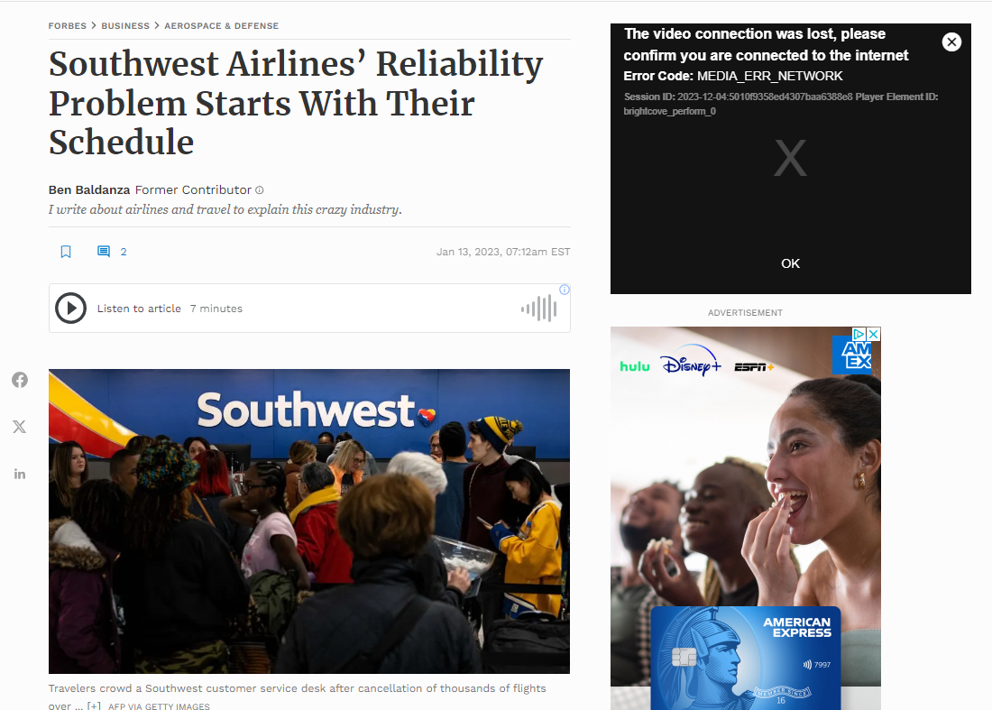
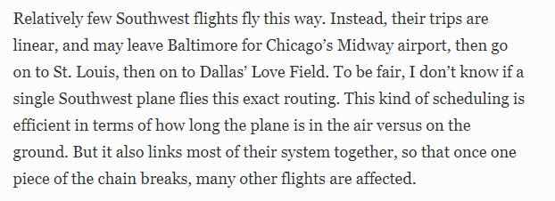
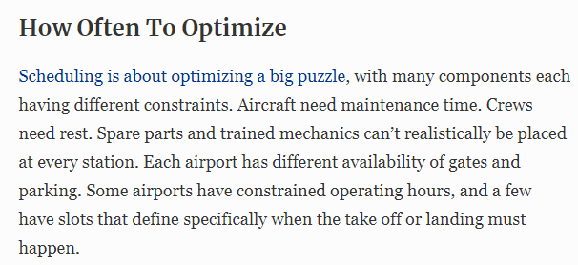

Slide 7
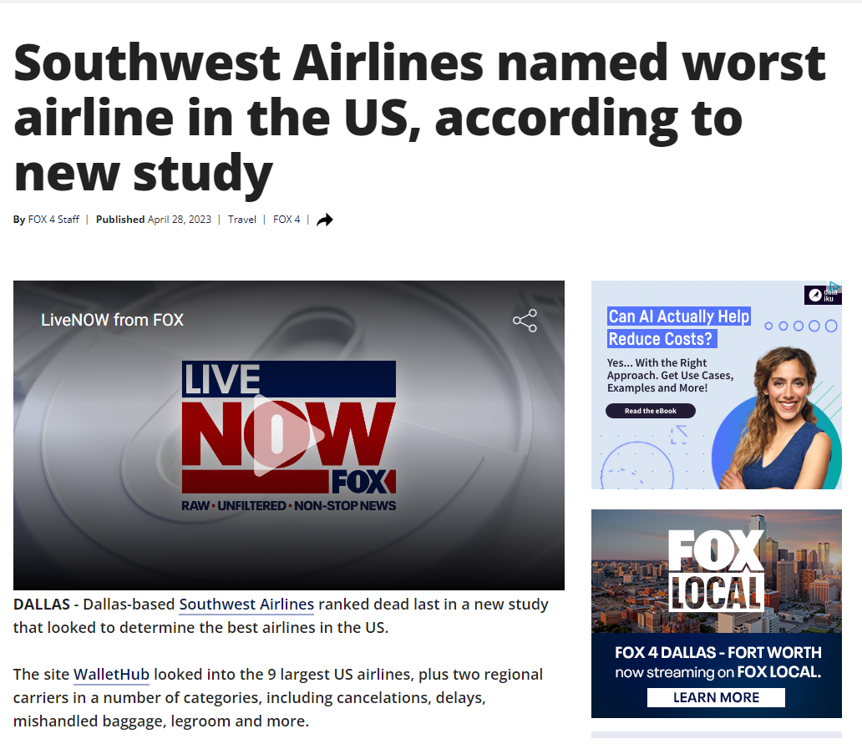

Slide 8
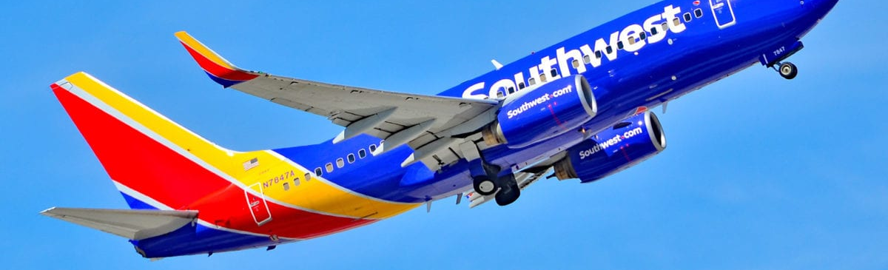
Conclusion
The analysis performed in this project was focused on an entire industry. This was not specifically targeted for a company, but the model could be applied to a single carrier. The main pursuit was to identify the airlines that had more delays and build an algorithm that could predict future delays. Southwest airlines demonstrated to have the most delays in our analysis.
We can conclude that Southwest airlines has had efficiency problems through 2023. In these articles it was emphasized the fact that their main problems rely on their schedules and their linear model

Slide 9
Sources
Colab: https://colab.research.google.com/drive/1YoLbEHwpBGNTb97KibCEKBnMQGgIJF-D?usp=sharing
Fox News: “Southwest Airlines named worst airline in the US, according to new study”:
https://www.fox4news.com/news/southwest-airlines-named-worst-airline-in-the-us-according-to-new-study.
Forbes: Southwest Airlines’ Reliability Problem Starts With Their Schedule
https://www.forbes.com/sites/benbaldanza/2023/01/13/southwest-airlines-reliability-problem-starts-with-their-schedule/?sh=4c387a2a5359
Data:
https://www.kaggle.com/datasets/sriharshaeedala/airline-delay/

